Slide 1

NarrativeLink: Schema & Queries
Team Orange | CSC3220 Draft Presentation | Mason Harris, Dan Kalenga, Alef Ramirez

Slide 2






Application Features
Offline & Private
Gamified Mechanics
Local Analytics
A fully offline command-line writing tool. Zero cloud dependencies guarantee that your creative drafts and metadata remain completely local and private.
Fights writer's block using a high-pressure "Chain Reaction" feature. Type related words against a strict countdown timer to build your narrative framework.
Uses an embedded SQLite database for lightning-fast local persistence and calculates Flesch Readability scores natively using heuristic algorithms.

Slide 3


Normalized Architecture
Core Entities (USER & STORY)
Game Mechanics (WORDCHAIN)
The schema perfectly isolates user accounts and their associated stories into distinct tables. This 3rd Normal Form separation ensures that user metadata, like average Flesch Readability scores, doesn't redundantly clutter the core narrative data, maintaining a clean and scalable architecture.
The core game logic is normalized into a robust many-to-many relationship structure. Word chains are explicitly linked to parent stories, while the CHAINWORD table acts as the associative entity connecting individual chains to the global WORDPOOL, tracking exact sequence orders.

Slide 4
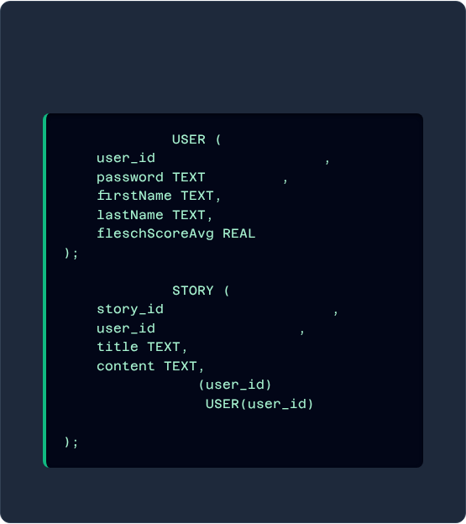
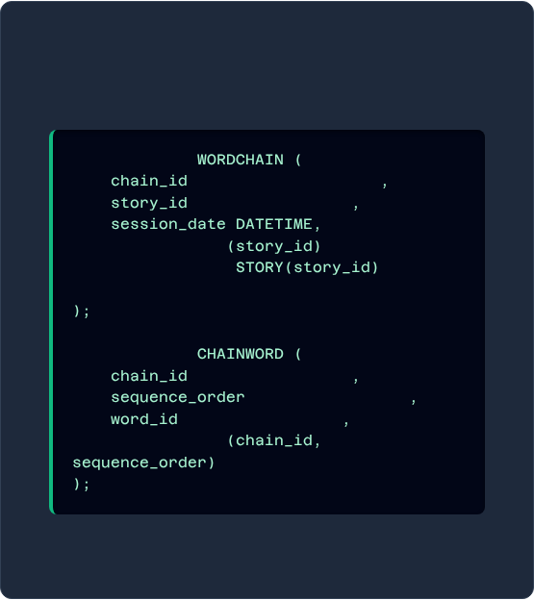
Schema Definition (DDL)
USER & STORY Tables
Game Mechanic Tables
CREATE TABLE
CREATE TABLE
INTEGER PRIMARY KEY
INTEGER PRIMARY KEY
NOT NULL
INTEGER NOT NULL
FOREIGN KEY
REFERENCES
ON DELETE CASCADE
CREATE TABLE
INTEGER PRIMARY KEY
CREATE TABLE
INTEGER NOT NULL
INTEGER NOT NULL
INTEGER NOT NULL
INTEGER NOT NULL
FOREIGN KEY
PRIMARY KEY
REFERENCES
ON DELETE CASCADE

Slide 5
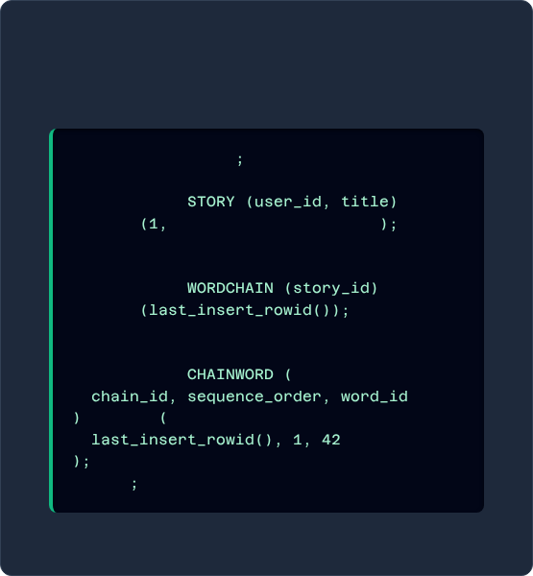
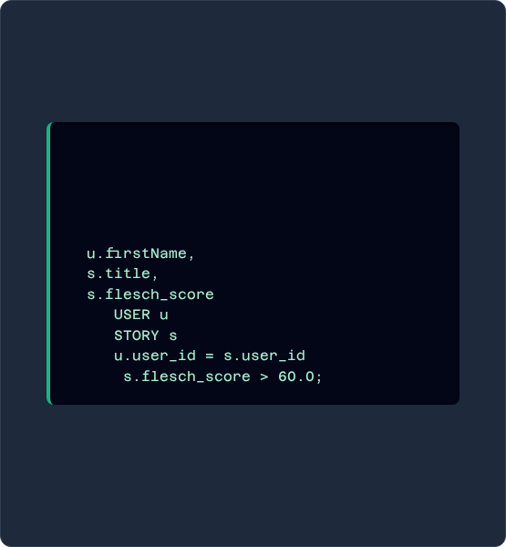
Data Manipulation (CREATE/READ)
INSERT Transaction
SELECT Statement
BEGIN TRANSACTION
-- Retrieves the first name, story -- title, and flesch score for -- stories scoring above 60.
-- 1. Create base story
INSERT INTO
VALUES
'The Silent Terminal'
SELECT
-- 2. Create word chain link
INSERT INTO
VALUES
FROM
-- 3. Insert linked chainwords
JOIN
INSERT INTO
ON
WHERE
VALUES
COMMIT

Slide 6
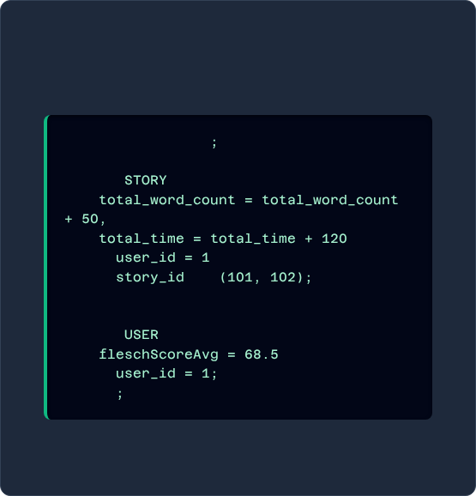
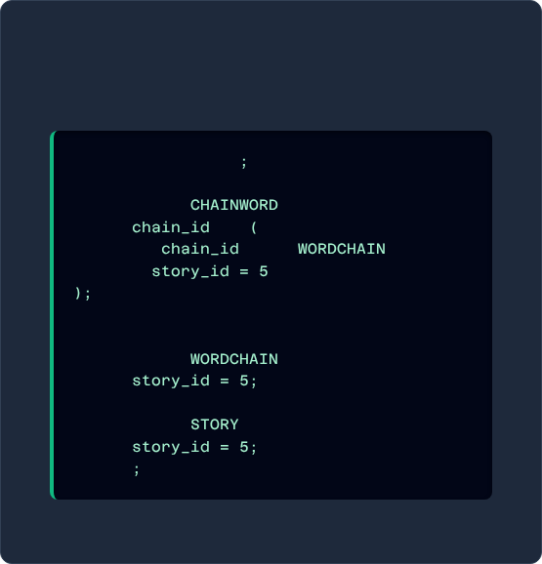
Data Manipulation (UPDATE/DELETE)
UPDATE Transaction
DELETE Transaction
BEGIN TRANSACTION
BEGIN TRANSACTION
-- 1. Update story statistics
-- Safely handle child cascades
UPDATE
DELETE FROM
SET
WHERE
IN
SELECT
FROM
WHERE
WHERE
AND
IN
-- Remove parent records
-- 2. Update user average
DELETE FROM
UPDATE
WHERE
SET
WHERE
DELETE FROM
COMMIT
WHERE
COMMIT

Slide 7
Live Demo
Empty Database ➔ Schema Initialized ➔ CRUD Verified

Slide 8
Questions?
Thank you for your feedback.

